Slide 1
Rich Mirror Alignment
27/11/2015 Claire Prouve

Slide 2
Current state
CAN run automatically now (whenever Clara makes it happen)
Option w/ or w/o calculation of magnification coefficients
All alignments will be copied to /group/online/AligWork/MirrorAlignments
Currently working on the monitoring What would you like to have monitored?

Slide 3
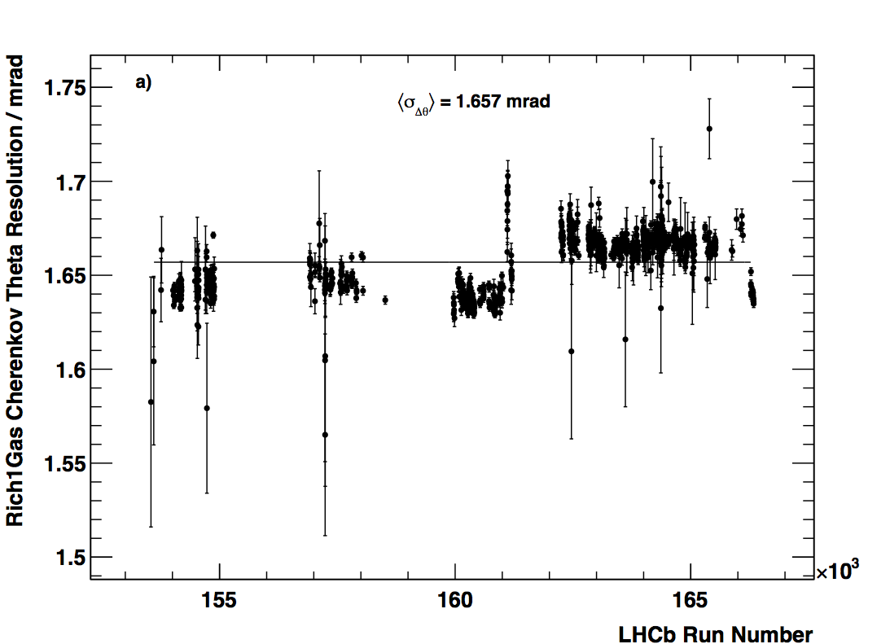
Mag Up/Down differences
DOWN
UP

Slide 4
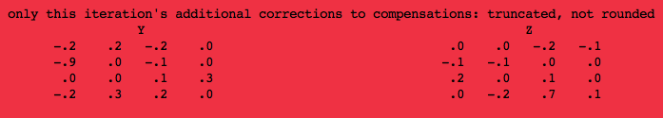
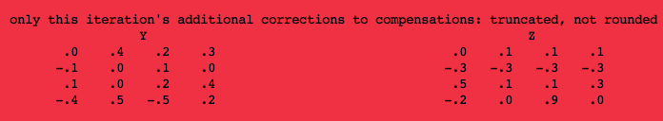
Mag Up/Down differences
Alignment DOWN:
Runs: 160087 160133 160163 160170 160172 160212 160214 160245 160365 160525 160597 160997
Alignment UP:
Runs: 162424 162428 162429 162832 162985 163364 163434 163596 164429 164524
Both converged after one iteration

Slide 5

Mag Up/Down differences
Mag DOWN
Cherenkov angle resolution
Iteration 0
Iteration 1
From Chris’ plot ~ 1.635 mrad
Mag UP
Cherenkov angle resolution
Iteration 0
Iteration 1
From Chris’ plot ~1.67 mrad
Iteration 0
Iteration 1
Iteration 0
Iteration 1
Ambiguous + unambiguous photons in the alignment selection, not the same as Chis has!!!!
Is our selection cutting out some effect?

Slide 6
Todo
Other alignments on same periods with different runs
Window for RICH1? Change range-> bigger range
Alignment on mixed up/down sample
Ambiguous + unambiguous photons in the alignment selection, not the same as Chis has!!!!
Is our selection cutting out some effect?

